Slide 1
Tacos KFT.
Lajka Kristóf, Váradi Ádám és Enyedi Sándor Projektmunkája

Slide 2

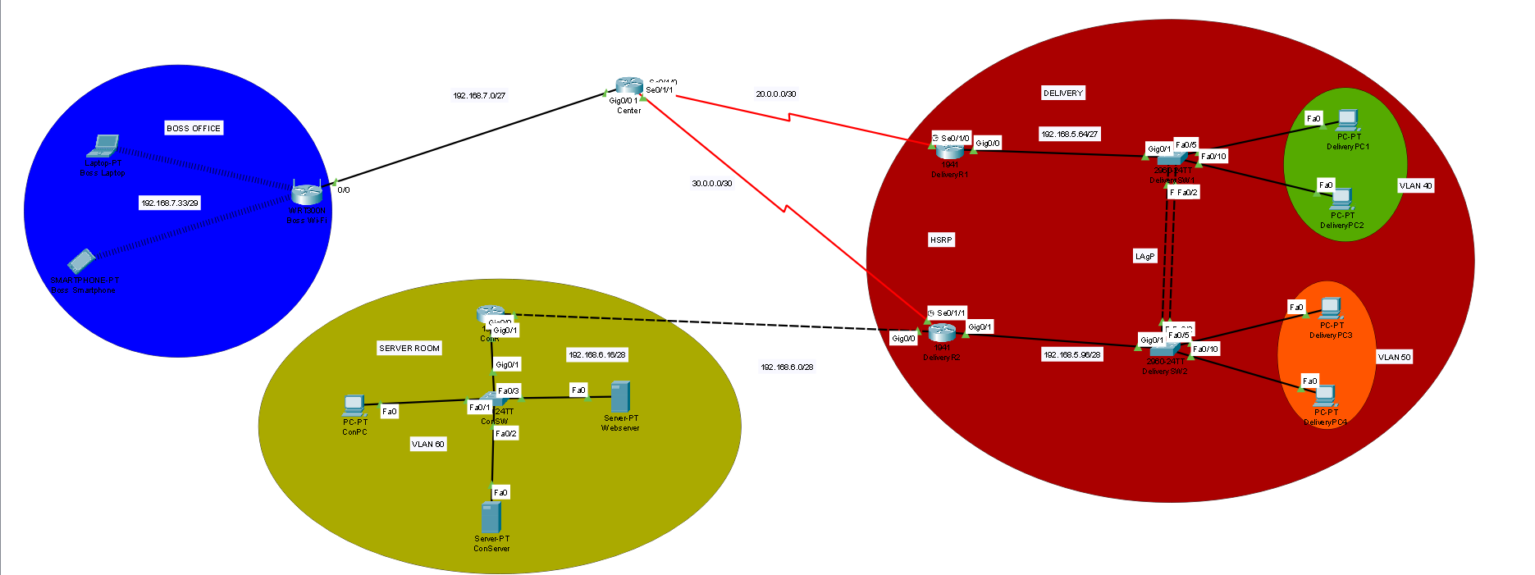



Topológia

Slide 3
IPv4/IPV6 tábla
Eszköz | Interface | IP | IPv6 | Subnet | Gateway
Center | Gig/0/0 Se0/1/0 Se0/1/1 | 192.168.7.1 20.0.0.1 30.0.0.1 | --------------------------------------------------------------------------------------------- | /27 /30 /30 | --------------------------------------------------------------------------------------------
Delivery R1 | Gig0/0.40 Se0/1/0 | 192.168.5.65 20.0.0.2 | 2001:ACAD:DB8:5::2/64 ------------------------------- | /27 /30 | ---------------------------------------------------------------------
Delivery R2 | Gig0/0.50 Se0/1/0 | 192.168.5.97 30.0.0.2 | 2001:ACAD:DB8:5::1/64 ------------------------------- | /28 /30 | ---------------------------------------------------------------------
ConR | Gig0/0 Gig0/1.60 | 192.168.6.2 192.168.6.17 | -------------------------------------------------------------- | /28 /28 | ---------------------------------------------------------------------
Boss Wi-Fi | Internet LAN | 192.168.7.2 192.168.7.33 | --------------------------------------------------------------------------------- | /29 /29 | 192.168.7.1
DeliverySW1 | VLAN 40 | ------------------------ | -------------- | --------- | ----------------------------------------------
DeliverySW2 | VLAN 50 | ------------------------ | -------------- | --------- | -----------------------
DeliveryPC1 | NIC | DHCP | SLAAC | /27 | 192.168.5.65
DeliveryPC2 | NIC | DHCP | SLAAC | /27 | 192.168.5.65
DeliveryPC3 | NIC | DCHP | SLAAC | /28 | 192.168.5.97
DeliveryPC4 | NIC | DHCP | SLAAC | /28 | 192.168.5.97
DeliveryServer | NIC | DHCP | SLAAC | /27 | 192.168.5.85
Laptop | Wireless | DHCP | -------------- | /29 | 192.168.7.1
Smartphone | Wireless | DHCP | -------------- | /29 | 192.168.7.1
ConPC | NIC | 192.168.6.20 | Stateful | /28 | 192.168.6.17
ConServer | NIC | 192.168.6.25 | 2001:ACAD:DB8:6::1/64 | /28 | 192.168.6.17

Slide 4
Vlan tábla
Eszköz neve | Azonosító | Név | Portok | Hálózat
DeliverySW1 | 40 99 | Delivery1 Trash | Fa0/5,Fa0/10,Fa0/3 | 192.168.5.64/27
DeliverySW2 | 50 99 | Delivery2 Trash | Fa0/5,Fa0/10 | 192.168.5.96/28
ConSW | 60 99 | ConVLAN Trash | Fa0/1, Fa0/2 | 192.168.6.16/28

Slide 5
Etherchannel
Protokoll | Port
LACP | Fa0/1, Fa0/2
LACP | Fa0/1, Fa0/2

Slide 6

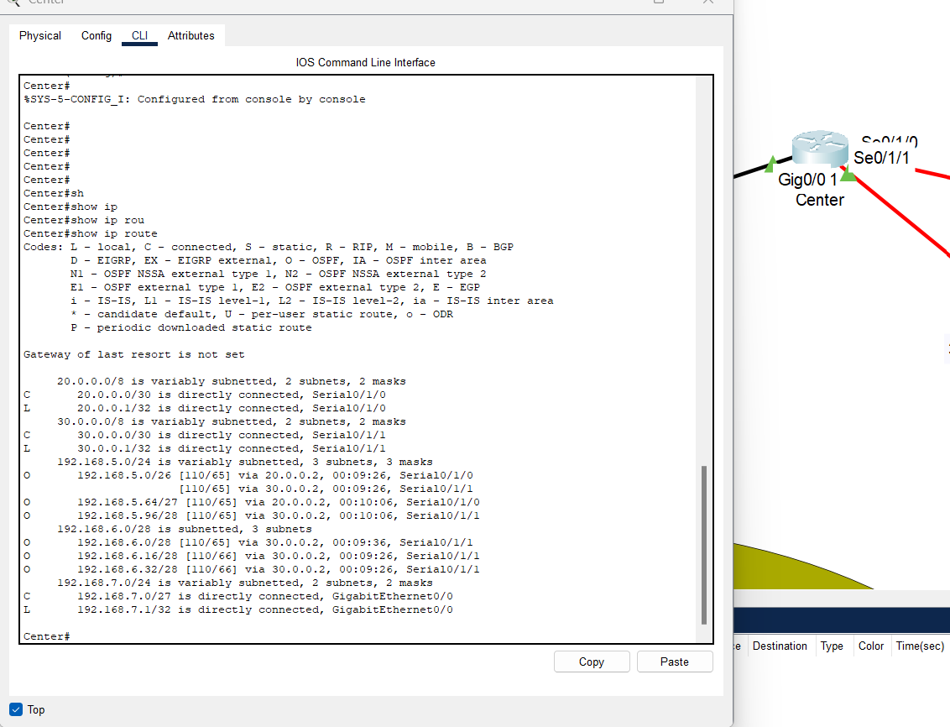
Route Table

Slide 7
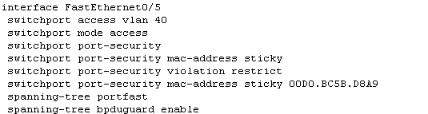
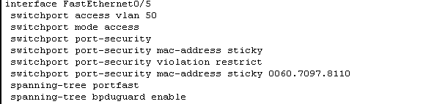
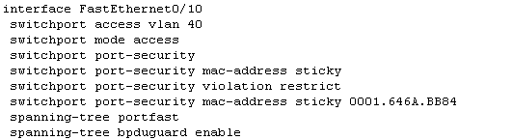
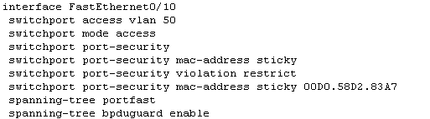
Port-Security,(BPDU Guard)
Delivery SW1
Delivery SW2

Slide 8
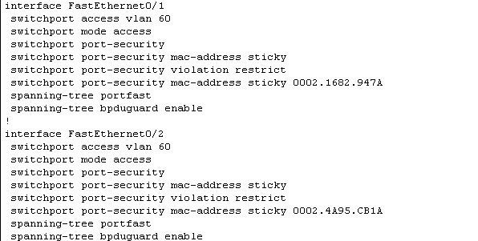
Port-Security,(BPDU Guard)

Slide 9
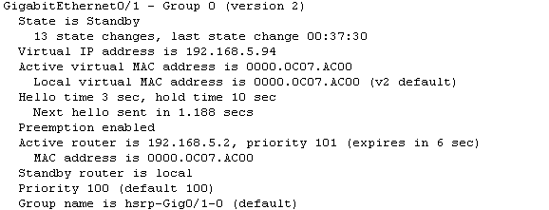
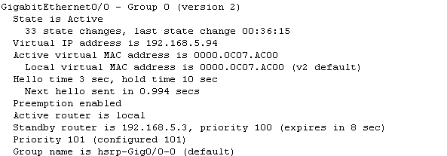
HSRP
DeliveryR1
DeliveryR2

Slide 10

NAT

Slide 11
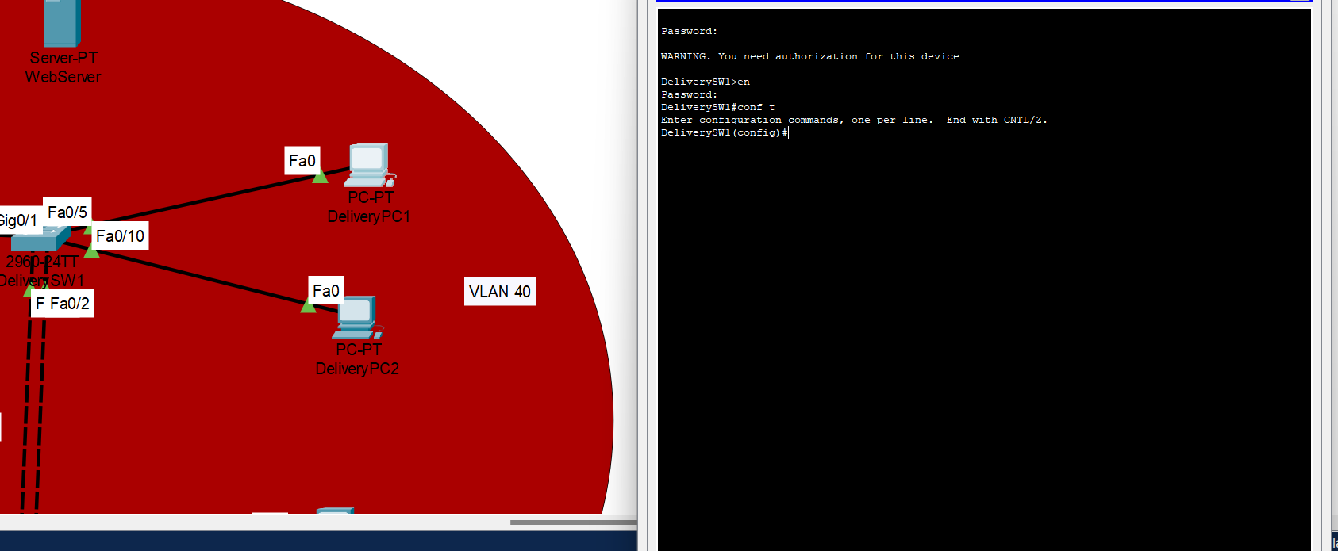
SSH

Slide 12
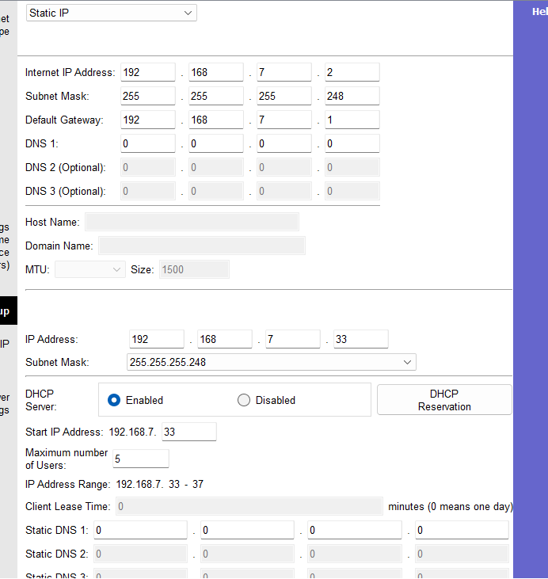
WIFI

Slide 13
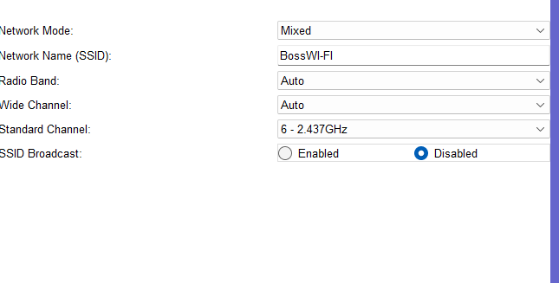
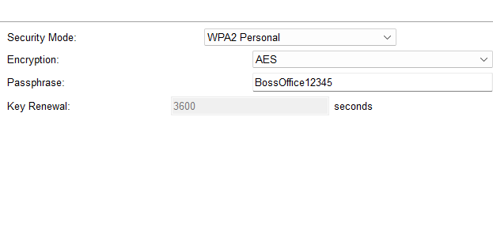
WIFI Security

Slide 14
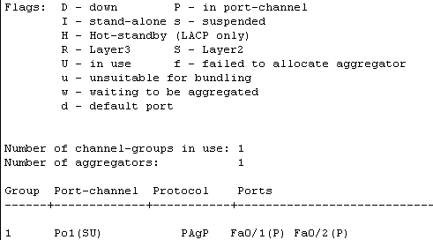
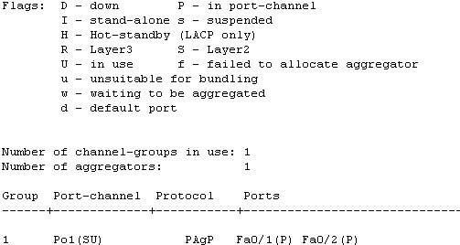
Etherchannel
Delivery SW1
DeliverySW2

Slide 15
Tesztelések

Slide 16
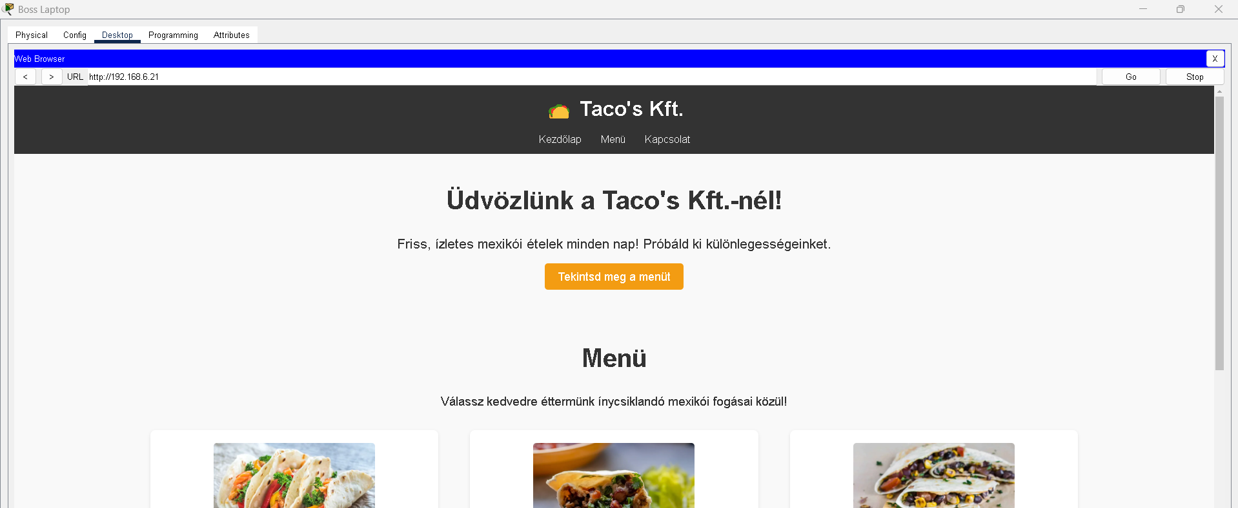
ACL

Slide 17
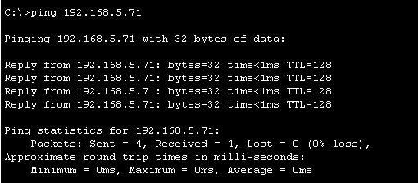
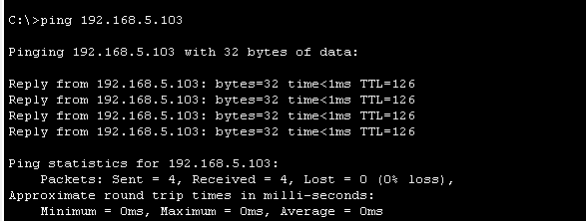
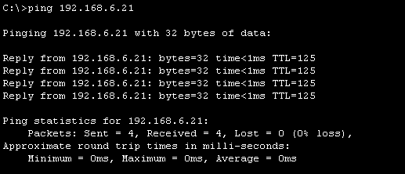
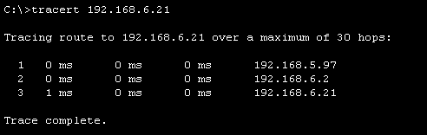
Pingelések
Beslő ping
Külső ping
Tracert
Szerver ping

Slide 18
Köszönjük a figyelmet!

